Slide 1
Unit-4 Learning
Dr. SONAM MITTAL
Associate Professor
IT Dept. BKBIET- Pilani

Slide 2
Overview of different type of Learning
Machine Learning (ML) is an automated learning with little or no human intervention.
It involves programming computers so that they learn from the available inputs.
The main purpose of machine learning is to explore and construct algorithms that can learn from the previous data and make predictions on new input data.

Slide 3
The input to a learning algorithm is training data, representing experience, and the output is any expertise, which usually takes the form of another algorithm that can perform a task.
The input data to a machine learning system can be numerical, textual, audio, visual, or multimedia.
The corresponding output data of the system can be a floating-point number, for instance, the velocity of a rocket, an integer representing a category or a class, for example, a pigeon or a sunflower from image recognition.

Slide 4
Concepts of Learning
Learning is the process of converting experience into expertise or knowledge.
Learning can be broadly classified into three categories, based on the nature of the learning data and interaction between the learner and the environment.
Supervised Learning
Unsupervised Learning
Semi-supervised Learning

Slide 5
Similarly, there are four categories of machine learning algorithms as shown below −
Supervised learning algorithm
Unsupervised learning algorithm
Semi-supervised learning algorithm
Reinforcement learning algorithm
However, the most commonly used ones are supervised and unsupervised learning.

Slide 6
Supervised Learning
Supervised learning is commonly used in real world applications, such as face and speech recognition, products or movie recommendations, and sales forecasting.
Supervised learning can be further classified into two types - Regression and Classification.
Regression trains on and predicts a continuous-valued response, for example predicting real estate prices.

Slide 7
Classification attempts to find the appropriate class label, such as analyzing positive/negative sentiment, male and female persons, benign and malignant tumors, secure and unsecure loans etc.
In supervised learning, learning data comes with description, labels, targets or desired outputs and the objective is to find a general rule that maps inputs to outputs. This kind of learning data is called labeled data.
The learned rule is then used to label new data with unknown outputs.

Slide 8
Supervised learning involves building a machine learning model that is based on labeled samples.
For example, if we build a system to estimate the price of a plot of land or a house based on various features, such as size, location, and so on, we first need to create a database and label it.
We need to teach the algorithm what features correspond to what prices.
Based on this data, the algorithm will learn how to calculate the price of real estate using the values of the input features.

Slide 9
Supervised learning deals with learning a function from available training data.
Here, a learning algorithm analyzes the training data and produces a derived function that can be used for mapping new examples.
There are many supervised learning algorithms such as Logistic Regression, Neural networks, Support Vector Machines (SVMs), and Naive Bayes classifiers.
Common examples of supervised learning include classifying e-mails into spam and not-spam categories, labeling webpages based on their content, and voice recognition.

Slide 10
Unsupervised Learning
Unsupervised learning is used to detect anomalies, outliers, such as fraud or defective equipment, or to group customers with similar behaviors for a sales campaign.
It is the opposite of supervised learning. There is no labeled data here.
When learning data contains only some indications without any description or labels, it is up to the coder or to the algorithm to find the structure of the underlying data, to discover hidden patterns, or to determine how to describe the data.
This kind of learning data is called unlabeled data.

Slide 11
Suppose that we have a number of data points, and we want to classify them into several groups.
We may not exactly know what the criteria of classification would be. So, an unsupervised learning algorithm tries to classify the given dataset into a certain number of groups in an optimum way.
Unsupervised learning algorithms are extremely powerful tools for analyzing data and for identifying patterns and trends.
They are most commonly used for clustering similar input into logical groups. Unsupervised learning algorithms include K-means, Random Forests, Hierarchical clustering and so on.

Slide 12
Semi-supervised Learning
If some learning samples are labeled, but some other are not labeled, then it is semi-supervised learning.
It makes use of a large amount of unlabeled data for training and a small amount of labeled data for testing.
Semi-supervised learning is applied in cases where it is expensive to acquire a fully labeled dataset while more practical to label a small subset.
For example, it often requires skilled experts to label certain remote sensing images, and lots of field experiments to locate oil at a particular location, while acquiring unlabeled data is relatively easy.

Slide 13
Reinforcement Learning
Here learning data gives feedback so that the system adjusts to dynamic conditions in order to achieve a certain objective.
The system evaluates its performance based on the feedback responses and reacts accordingly.
The best known instances include self-driving cars and chess master algorithm AlphaGo.

Slide 14
Purpose of Machine Learning
Machine learning can be seen as a branch of AI or Artificial Intelligence, since, the ability to change experience into expertise or to detect patterns in complex data is a mark of human or animal intelligence.
As a field of science, machine learning shares common concepts with other disciplines such as statistics, information theory, game theory, and optimization.
As a subfield of information technology, its objective is to program machines so that they will learn.

Slide 15
However, it is to be seen that, the purpose of machine learning is not building an automated duplication of intelligent behavior, but using the power of computers to complement and supplement human intelligence.
For example, machine learning programs can scan and process huge databases detecting patterns that are beyond the scope of human perception.

Slide 16
Supervised Machine Learning
Supervised learning is the types of machine learning in which machines are trained using well "labelled" training data, and on basis of that data, machines predict the output.
The labelled data means some input data is already tagged with the correct output.
In supervised learning, the training data provided to the machines work as the supervisor that teaches the machines to predict the output correctly.
It applies the same concept as a student learns in the supervision of the teacher.

Slide 17
Supervised learning is a process of providing input data as well as correct output data to the machine learning model.
The aim of a supervised learning algorithm is to find a mapping function to map the input variable(x) with the output variable(y).
In the real-world, supervised learning can be used for Risk Assessment, Image classification, Fraud Detection, spam filtering, etc.

Slide 18
How Supervised Learning Works?
In supervised learning, models are trained using labelled dataset, where the model learns about each type of data.
Once the training process is completed, the model is tested on the basis of test data (a subset of the training set), and then it predicts the output.
Suppose we have a dataset of different types of shapes which includes square, rectangle, triangle, and Polygon. Now the first step is that we need to train the model for each shape.

Slide 19
If the given shape has four sides, and all the sides are equal, then it will be labelled as a Square.
If the given shape has three sides, then it will be labelled as a triangle.
If the given shape has six equal sides then it will be labelled as hexagon.
Now, after training, we test our model using the test set, and the task of the model is to identify the shape.
The machine is already trained on all types of shapes, and when it finds a new shape, it classifies the shape on the bases of a number of sides, and predicts the output.

Slide 20
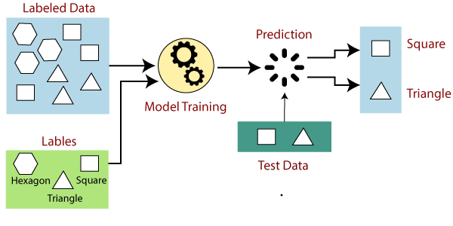

Slide 21
Steps Involved in Supervised Learning:
First Determine the type of training dataset
Collect/Gather the labelled training data.
Split the training dataset into training dataset, test dataset, and validation dataset.
Determine the input features of the training dataset, which should have enough knowledge so that the model can accurately predict the output.

Slide 22
Determine the suitable algorithm for the model, such as support vector machine, decision tree, etc.
Execute the algorithm on the training dataset.
Sometimes we need validation sets as the control parameters, which are the subset of training datasets.
Evaluate the accuracy of the model by providing the test set. If the model predicts the correct output, which means our model is accurate.

Slide 23
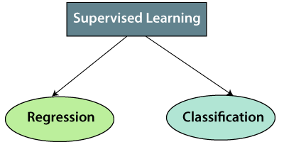
Types of supervised Machine learning Algorithms:
Supervised learning can be further divided into two types of problems:

Slide 24
1. Regression
Regression algorithms are used if there is a relationship between the input variable and the output variable.
It is used for the prediction of continuous variables, such as Weather forecasting, Market Trends, etc. Below are some popular Regression algorithms which come under supervised learning:
Linear Regression
Regression Trees
Non-Linear Regression
Bayesian Linear Regression
Polynomial Regression

Slide 25
2. Classification
Classification algorithms are used when the output variable is categorical, which means there are two classes such as Yes-No, Male-Female, True-false, etc.
Random Forest
Decision Trees
Logistic Regression
Support vector Machines

Slide 26
Advantages of Supervised learning:
With the help of supervised learning, the model can predict the output on the basis of prior experiences.
In supervised learning, we can have an exact idea about the classes of objects.
Supervised learning model helps us to solve various real-world problems such as fraud detection, spam filtering, etc.

Slide 27
Disadvantages of supervised learning:
Supervised learning models are not suitable for handling the complex tasks.
Supervised learning cannot predict the correct output if the test data is different from the training dataset.
Training required lots of computation times.
In supervised learning, we need enough knowledge about the classes of object.

Slide 28
Unsupervised Machine Learning
What is Unsupervised Learning?
As the name suggests, unsupervised learning is a machine learning technique in which models are not supervised using training dataset.
Instead, models itself find the hidden patterns and insights from the given data.
It can be compared to learning which takes place in the human brain while learning new things. It can be defined as:
Unsupervised learning is a type of machine learning in which models are trained using unlabeled dataset and are allowed to act on that data without any supervision.

Slide 29
Unsupervised learning cannot be directly applied to a regression or classification problem because unlike supervised learning, we have the input data but no corresponding output data.
The goal of unsupervised learning is to find the underlying structure of dataset, group that data according to similarities, and represent that dataset in a compressed format.
Example: Suppose the unsupervised learning algorithm is given an input dataset containing images of different types of cats and dogs.
The algorithm is never trained upon the given dataset, which means it does not have any idea about the features of the dataset.

Slide 30
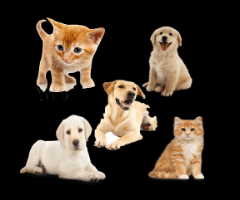
The task of the unsupervised learning algorithm is to identify the image features on their own. Unsupervised learning algorithm will perform this task by clustering the image dataset into the groups according to similarities between images.

Slide 31
Why use Unsupervised Learning?
Unsupervised learning is helpful for finding useful insights from the data.
Unsupervised learning is much similar as a human learns to think by their own experiences, which makes it closer to the real AI.
Unsupervised learning works on unlabeled and uncategorized data which make unsupervised learning more important.
In real-world, we do not always have input data with the corresponding output so to solve such cases, we need unsupervised learning.

Slide 32
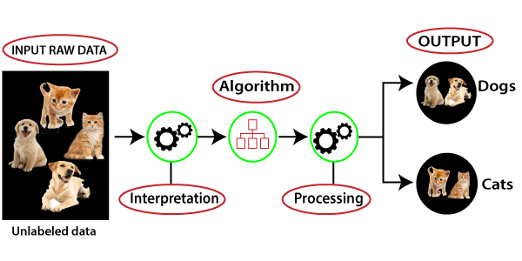
Working of Unsupervised Learning
Working of unsupervised learning can be understood by the below diagram:

Slide 33
Here, we have taken an unlabeled input data, which means it is not categorized and corresponding outputs are also not given.
Now, this unlabeled input data is fed to the machine learning model in order to train it.
Firstly, it will interpret the raw data to find the hidden patterns from the data and then will apply suitable algorithms such as k-means clustering, Decision tree, etc.
Once it applies the suitable algorithm, the algorithm divides the data objects into groups according to the similarities and difference between the objects.

Slide 34
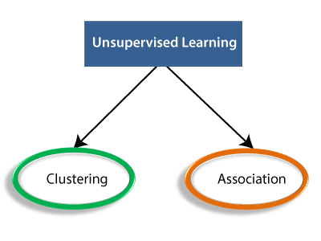
Types of Unsupervised Learning Algorithm:
The unsupervised learning algorithm can be further categorized into two types of problems:

Slide 35
Clustering:
Clustering is a method of grouping the objects into clusters such that objects with most similarities remains into a group and has less or no similarities with the objects of another group.
Cluster analysis finds the commonalities between the data objects and categorizes them as per the presence and absence of those commonalities.

Slide 36
Association:
An association rule is an unsupervised learning method which is used for finding the relationships between variables in the large database.
It determines the set of items that occurs together in the dataset.
Association rule makes marketing strategy more effective. Such as people who buy X item (suppose a bread) are also tend to purchase Y (Butter/Jam) item.
A typical example of Association rule is Market Basket Analysis.

Slide 37
Unsupervised Learning algorithms:
Below is the list of some popular unsupervised learning algorithms:
K-means clustering
KNN (k-nearest neighbors)
Hierarchal clustering
Anomaly detection
Neural Networks
Principle Component Analysis
Independent Component Analysis
Apriori algorithm
Singular value decomposition

Slide 38
Advantages of Unsupervised Learning
Unsupervised learning is used for more complex tasks as compared to supervised learning because, in unsupervised learning, we don't have labeled input data.
Unsupervised learning is preferable as it is easy to get unlabeled data in comparison to labeled data.

Slide 39
Disadvantages of Unsupervised Learning
Unsupervised learning is intrinsically more difficult than supervised learning as it does not have corresponding output.
The result of the unsupervised learning algorithm might be less accurate as input data is not labeled, and algorithms do not know the exact output in advance.

Slide 40
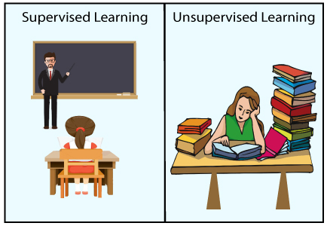
Difference between Supervised and Unsupervised Learning

Slide 41
Supervised Learning | Unsupervised Learning
Supervised learning algorithms are trained using labeled data. | Unsupervised learning algorithms are trained using unlabeled data.
Supervised learning model takes direct feedback to check if it is predicting correct output or not. | Unsupervised learning model does not take any feedback.
Supervised learning model predicts the output. | Unsupervised learning model finds the hidden patterns in data.
In supervised learning, input data is provided to the model along with the output. | In unsupervised learning, only input data is provided to the model.

Slide 42
The goal of supervised learning is to train the model so that it can predict the output when it is given new data. | The goal of unsupervised learning is to find the hidden patterns and useful insights from the unknown dataset.
Supervised learning needs supervision to train the model. | Unsupervised learning does not need any supervision to train the model.
Supervised learning can be categorized in Classification and Regression problems. | Unsupervised Learning can be classified in Clustering and Associations problems.
Supervised learning can be used for those cases where we know the input as well as corresponding outputs. | Unsupervised learning can be used for those cases where we have only input data and no corresponding output data.

Slide 43
Supervised learning model produces an accurate result. | Unsupervised learning model may give less accurate result as compared to supervised learning.
Supervised learning is not close to true Artificial intelligence as in this, we first train the model for each data, and then only it can predict the correct output. | Unsupervised learning is more close to the true Artificial Intelligence as it learns similarly as a child learns daily routine things by his experiences.
It includes various algorithms such as Linear Regression, Logistic Regression, Support Vector Machine, Multi-class Classification, Decision tree, Bayesian Logic, etc. | It includes various algorithms such as Clustering, KNN, and Apriori algorithm.

Slide 44
Support Vector Machine Algorithm
Support Vector Machine or SVM is one of the most popular Supervised Learning algorithms, which is used for Classification as well as Regression problems.
However, primarily, it is used for Classification problems in Machine Learning.
The goal of the SVM algorithm is to create the best line or decision boundary that can segregate n-dimensional space into classes so that we can easily put the new data point in the correct category in the future.
This best decision boundary is called a hyperplane.

Slide 45
SVM chooses the extreme points/vectors that help in creating the hyperplane.
These extreme cases are called as support vectors, and hence algorithm is termed as Support Vector Machine.
Consider the below diagram in which there are two different categories that are classified using a decision boundary or hyperplane:

Slide 46


Slide 47
Example:
Suppose we see a strange cat that also has some features of dogs, so if we want a model that can accurately identify whether it is a cat or dog, so such a model can be created by using the SVM algorithm.
We will first train our model with lots of images of cats and dogs so that it can learn about different features of cats and dogs, and then we test it with this strange creature.
So as support vector creates a decision boundary between these two data (cat and dog) and choose extreme cases (support vectors), it will see the extreme case of cat and dog. On the basis of the support vectors, it will classify it as a cat.

Slide 48
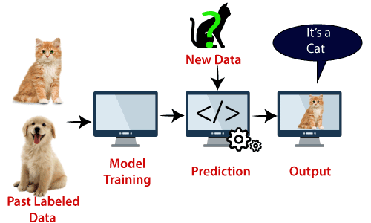
SVM algorithm can be used for Face detection, image classification, text categorization, etc.

Slide 49
Types of SVM
SVM can be of two types:
Linear SVM: Linear SVM is used for linearly separable data, which means if a dataset can be classified into two classes by using a single straight line, then such data is termed as linearly separable data, and classifier is used called as Linear SVM classifier.
Non-linear SVM: Non-Linear SVM is used for non-linearly separated data, which means if a dataset cannot be classified by using a straight line, then such data is termed as non-linear data and classifier used is called as Non-linear SVM classifier.

Slide 50
Hyperplane and Support Vectors in the SVM algorithm:
Hyperplane:
There can be multiple lines/decision boundaries to segregate the classes in n-dimensional space, but we need to find out the best decision boundary that helps to classify the data points. This best boundary is known as the hyperplane of SVM.
The dimensions of the hyperplane depend on the features present in the dataset, which means if there are 2 features then hyperplane will be a straight line. And if there are 3 features, then hyperplane will be a 2-dimension plane.

Slide 51
We always create a hyperplane that has a maximum margin, which means the maximum distance between the data points.
Support Vectors:
The data points or vectors that are the closest to the hyperplane and which affect the position of the hyperplane are termed as Support Vector.
Since these vectors support the hyperplane, hence called a Support vector.

Slide 52
How does SVM works?
Linear SVM:
The working of the SVM algorithm can be understood by using an example.
Suppose we have a dataset that has two tags (green and blue), and the dataset has two features x1 and x2.
We want a classifier that can classify the pair(x1, x2) of coordinates in either green or blue. Consider the below image:

Slide 53
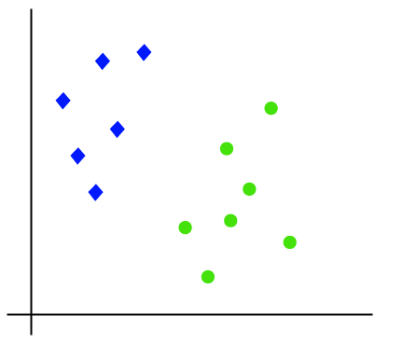

Slide 54
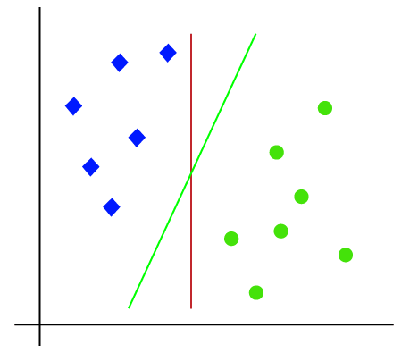
So as it is 2-d space so by just using a straight line, we can easily separate these two classes. But there can be multiple lines that can separate these classes. Consider the image:

Slide 55
Hence, the SVM algorithm helps to find the best line or decision boundary; this best boundary or region is called as a hyperplane.
SVM algorithm finds the closest point of the lines from both the classes.
These points are called support vectors.
The distance between the vectors and the hyperplane is called as margin. And the goal of SVM is to maximize this margin.
The hyperplane with maximum margin is called the optimal hyperplane.

Slide 56
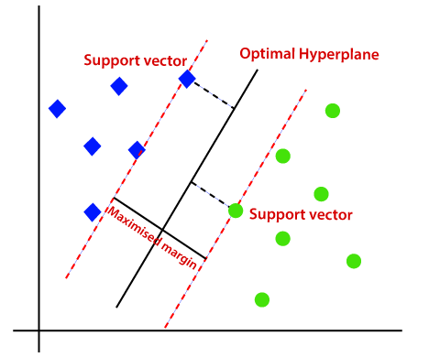

Slide 57
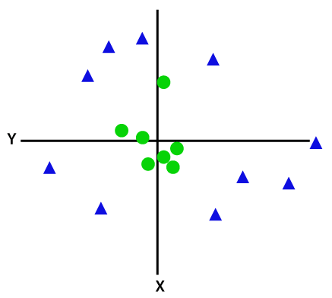
Non-Linear SVM:
If data is linearly arranged, then we can separate it by using a straight line, but for non-linear data, we cannot draw a single straight line. Consider the below image:

Slide 58
So to separate these data points, we need to add one more dimension. For linear data, we have used two dimensions x and y, so for non-linear data, we will add a third dimension z. It can be calculated as:
z=x² +y²
By adding the third dimension, the sample space will become as below image:

Slide 59
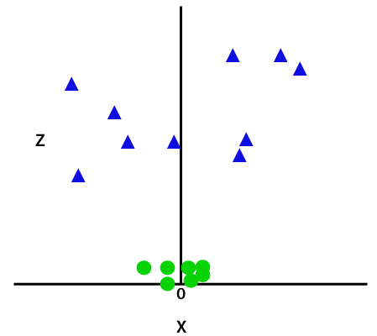

Slide 60
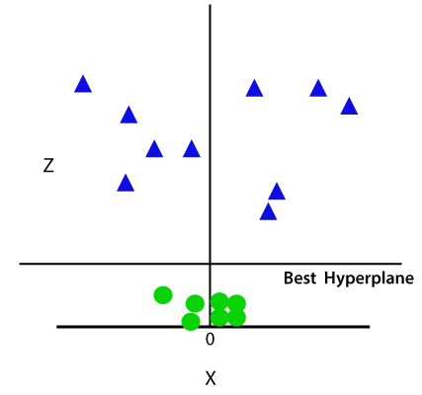
So now, SVM will divide the datasets into classes in the following way. Consider the below image:
Since we are in 3-d Space, hence it is looking like a plane parallel to the x-axis.

Slide 61
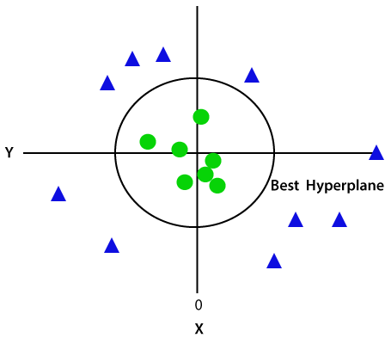
If we convert it in 2d space with z=1, then it will become as:
Hence we get a circumference of radius 1 in case of non-linear data.

Slide 62
Decision Tree Classification Algorithm
Decision Tree is a Supervised learning technique that can be used for both classification and Regression problems, but mostly it is preferred for solving Classification problems.
It is a tree-structured classifier, where internal nodes represent the features of a dataset, branches represent the decision rules and each leaf node represents the outcome.
In a Decision tree, there are two nodes, which are the Decision Node and Leaf Node.

Slide 63
Decision nodes are used to make any decision and have multiple branches, whereas Leaf nodes are the output of those decisions and do not contain any further branches.
The decisions or the test are performed on the basis of features of the given dataset.
It is a graphical representation for getting all the possible solutions to a problem/decision based on given conditions.
It is called a decision tree because, similar to a tree, it starts with the root node, which expands on further branches and constructs a tree-like structure.

Slide 64
In order to build a tree, we use the CART algorithm, which stands for Classification and Regression Tree algorithm.
A decision tree simply asks a question, and based on the answer (Yes/No), it further split the tree into subtrees.
A decision tree can contain categorical data (YES/NO) as well as numeric data.
Below diagram explains the general structure of a decision tree:

Slide 65


Slide 66
Why use Decision Trees?
There are various algorithms in Machine learning, so choosing the best algorithm for the given dataset and problem is the main point to remember while creating a machine learning model. Below are the two reasons for using the Decision tree:
Decision Trees usually mimic human thinking ability while making a decision, so it is easy to understand.
The logic behind the decision tree can be easily understood because it shows a tree-like structure.

Slide 67
Decision Tree Terminologies
Root Node: Root node is from where the decision tree starts. It represents the entire dataset, which further gets divided into two or more homogeneous sets.
Leaf Node: Leaf nodes are the final output node, and the tree cannot be segregated further after getting a leaf node.
Branch/Sub Tree: A tree formed by splitting the tree.
Splitting: Splitting is the process of dividing the decision node/root node into sub-nodes according to the given conditions.
Pruning: Pruning is the process of removing the unwanted branches from the tree.
Parent/Child node: The root node of the tree is called the parent node, and other nodes are called the child nodes.

Slide 68
How does the Decision Tree algorithm Work?
Step-1: Begin the tree with the root node, says S, which contains the complete dataset.
Step-2: Find the best attribute in the dataset using Attribute Selection Measure (ASM).
Step-3: Divide the S into subsets that contains possible values for the best attributes.
Step-4: Generate the decision tree node, which contains the best attribute.
Step-5: Recursively make new decision trees using the subsets of the dataset created in step -3. Continue this process until a stage is reached where you cannot further classify the nodes and called the final node as a leaf node.

Slide 69
Example: Suppose there is a candidate who has a job offer and wants to decide whether he should accept the offer or Not. So, to solve this problem, the decision tree starts with the root node (Salary attribute by ASM). The root node splits further into the next decision node (distance from the office) and one leaf node based on the corresponding labels. The next decision node further gets split into one decision node (Cab facility) and one leaf node. Finally, the decision node splits into two leaf nodes (Accepted offers and Declined offer). Consider the below diagram:

Slide 70
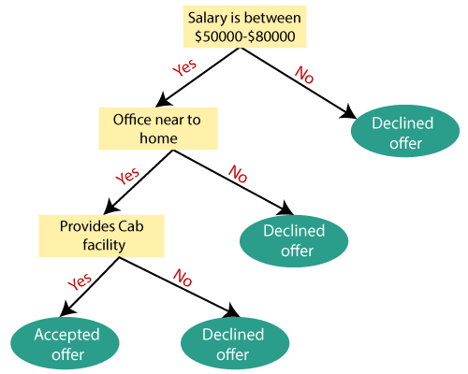

Slide 71
Attribute Selection Measures
While implementing a Decision tree, the main issue arises that how to select the best attribute for the root node and for sub-nodes.
So, to solve such problems there is a technique which is called as Attribute selection measure or ASM.
By this measurement, we can easily select the best attribute for the nodes of the tree. There are two popular techniques for ASM, which are:
Information Gain
Gini Index

Slide 72
1. Information Gain:
Information gain is the measurement of changes in entropy after the segmentation of a dataset based on an attribute.
It calculates how much information a feature provides us about a class.
According to the value of information gain, we split the node and build the decision tree.
A decision tree algorithm always tries to maximize the value of information gain, and a node/attribute having the highest information gain is split first.

Slide 73
It can be calculated using the below formula:
Information Gain= Entropy(S)- [(Weighted Avg) *Entropy(each feature)
Entropy: Entropy is a metric to measure the impurity in a given attribute. It specifies randomness in data. Entropy can be calculated as:
Entropy(s)= -P(yes)log2 P(yes)- P(no) log2 P(no)
Where,
S= Total number of samples
P(yes)= probability of yes
P(no)= probability of no

Slide 74
2. Gini Index:
Gini index is a measure of impurity or purity used while creating a decision tree in the CART(Classification and Regression Tree) algorithm.
An attribute with the low Gini index should be preferred as compared to the high Gini index.
It only creates binary splits, and the CART algorithm uses the Gini index to create binary splits.
Gini index can be calculated using the below formula:
Gini Index= 1- ∑_{j}P_{j}²

Slide 75
Pruning: Getting an Optimal Decision tree
Pruning is a process of deleting the unnecessary nodes from a tree in order to get the optimal decision tree.
A too-large tree increases the risk of overfitting, and a small tree may not capture all the important features of the dataset.
Therefore, a technique that decreases the size of the learning tree without reducing accuracy is known as Pruning.
There are mainly two types of tree pruning technology used:
Cost Complexity Pruning
Reduced Error Pruning.

Slide 76
Advantages of the Decision Tree
It is simple to understand as it follows the same process which a human follow while making any decision in real-life.
It can be very useful for solving decision-related problems.
It helps to think about all the possible outcomes for a problem.
There is less requirement of data cleaning compared to other algorithms.

Slide 77
Disadvantages of the Decision Tree
The decision tree contains lots of layers, which makes it complex.
It may have an overfitting issue, which can be resolved using the Random Forest algorithm.
For more class labels, the computational complexity of the decision tree may increase.

Slide 78
Artificial Neural Network
What is Artificial Neural Network?
The term "Artificial Neural Network" is derived from Biological neural networks that develop the structure of a human brain.
Similar to the human brain that has neurons interconnected to one another, artificial neural networks also have neurons that are interconnected to one another in various layers of the networks. These neurons are known as nodes.

Slide 79
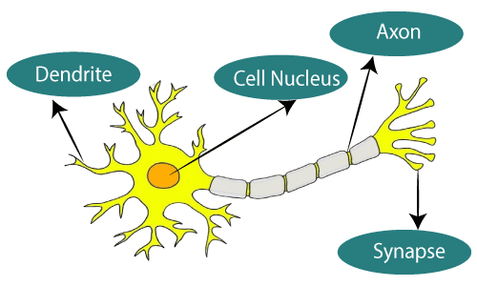

Slide 80
The idea of ANNs is based on the belief that working of human brain by making the right connections, can be imitated using silicon and wires as living neurons and dendrites.
The human brain is composed of 86 billion nerve cells called neurons.
They are connected to other thousand cells by Axons.
Stimuli from external environment or inputs from sensory organs are accepted by dendrites.
These inputs create electric impulses, which quickly travel through the neural network. A neuron can then send the message to other neuron to handle the issue or does not send it forward.

Slide 81
ANNs are composed of multiple nodes, which imitate biological neurons of human brain.
The neurons are connected by links and they interact with each other.
The nodes can take input data and perform simple operations on the data.
The result of these operations is passed to other neurons.
The output at each node is called its activation or node value.
Each link is associated with weight. ANNs are capable of learning, which takes place by altering weight values.
The following illustration shows a simple ANN −

Slide 82
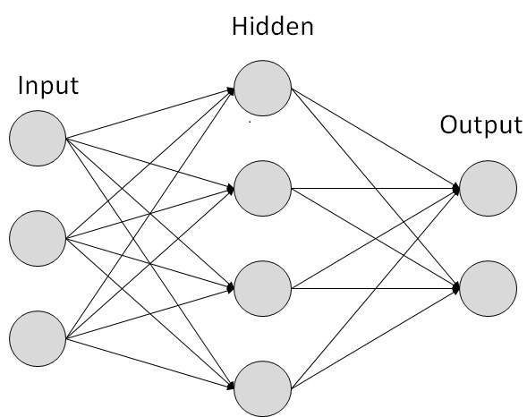

Slide 83
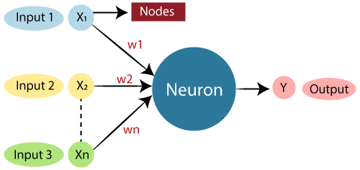
The typical Artificial Neural Network looks something like the given figure.

Slide 84
Dendrites from Biological Neural Network represent inputs in Artificial Neural Networks, cell nucleus represents Nodes, synapse represents Weights, and Axon represents Output.
Relationship between Biological neural network and artificial neural network:
Biological Neural Network | Artificial Neural Network
Dendrites | Inputs
Cell nucleus | Nodes
Synapse | Weights
Axon | Output

Slide 85
An Artificial Neural Network in the field of Artificial intelligence where it attempts to mimic the network of neurons makes up a human brain so that computers will have an option to understand things and make decisions in a human-like manner.
The artificial neural network is designed by programming computers to behave simply like interconnected brain cells.

Slide 86
We can understand the artificial neural network with an example, consider an example of a digital logic gate that takes an input and gives an output.
"OR" gate, which takes two inputs.
If one or both the inputs are "On," then we get "On" in output.
If both the inputs are "Off," then we get "Off" in output.
Here the output depends upon input.
Our brain does not perform the same task. The outputs to inputs relationship keep changing because of the neurons in our brain, which are "learning."

Slide 87
The architecture of an artificial neural network:
To understand the concept of the architecture of an artificial neural network, we have to understand what a neural network consists of.
In order to define a neural network that consists of a large number of artificial neurons, which are termed units arranged in a sequence of layers.
Lets us look at various types of layers available in an artificial neural network.

Slide 88
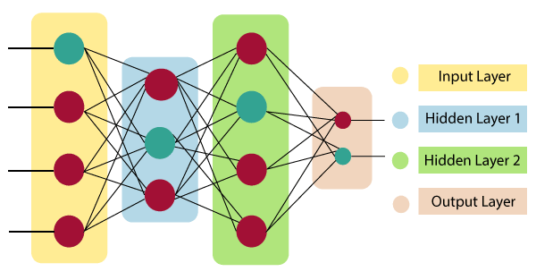
Artificial Neural Network primarily consists of three layers:

Slide 89
Input Layer:
As the name suggests, it accepts inputs in several different formats provided by the programmer.
Hidden Layer:
The hidden layer presents in-between input and output layers. It performs all the calculations to find hidden features and patterns.
Output Layer:
The input goes through a series of transformations using the hidden layer, which finally results in output that is conveyed using this layer.

Slide 90

The artificial neural network takes input and computes the weighted sum of the inputs and includes a bias. This computation is represented in the form of a transfer function.
It determines weighted total is passed as an input to an activation function to produce the output.
Activation functions choose whether a node should fire or not. Only those who are fired make it to the output layer.
There are distinctive activation functions available that can be applied upon the sort of task we are performing.

Slide 91
Types of Artificial Neural Networks
There are two Artificial Neural Network topologies
- Feed Forward and
- Feedback.
Feed Forward ANN
In this ANN, the information flow is unidirectional.
A unit sends information to other unit from which it does not receive any information.
There are no feedback loops. They are used in pattern generation/recognition/classification.
They have fixed inputs and outputs.

Slide 92
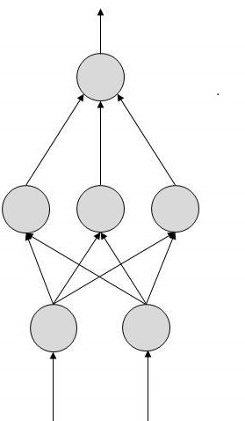

Slide 93
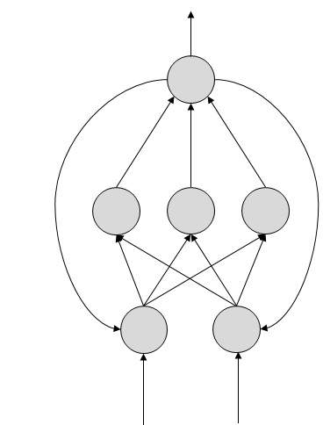
Feed Back ANN
Here, feedback loops are allowed.
They are used in content addressable memories.

Slide 94
Advantages of Artificial Neural Network (ANN)
Parallel processing capability:
Artificial neural networks have a numerical value that can perform more than one task simultaneously.
Storing data on the entire network:
Data that is used in traditional programming is stored on the whole network, not on a database.
The disappearance of a couple of pieces of data in one place doesn't prevent the network from working.

Slide 95
Capability to work with incomplete knowledge:
After ANN training, the information may produce output even with inadequate data. The loss of performance here relies upon the significance of missing data.
Having fault tolerance:
Extortion of one or more cells of ANN does not prohibit it from generating output, and this feature makes the network fault-tolerance.

Slide 96
Having a memory distribution:
For ANN is to be able to adapt, it is important to determine the examples and to encourage the network according to the desired output by demonstrating these examples to the network.
The succession of the network is directly proportional to the chosen instances, and if the event can't appear to the network in all its aspects, it can produce false output.

Slide 97
Disadvantages of Artificial Neural Network:
Assurance of proper network structure:
There is no particular guideline for determining the structure of artificial neural networks. The appropriate network structure is accomplished through experience, trial, and error.
Unrecognized behavior of the network:
It is the most significant issue of ANN. When ANN produces a testing solution, it does not provide insight concerning why and how. It decreases trust in the network.

Slide 98
Hardware dependence:
Artificial neural networks need processors with parallel processing power, as per their structure. Therefore, the realization of the equipment is dependent.
The duration of the network is unknown:
The network is reduced to a specific value of the error, and this value does not give us optimum results.

Slide 99
Difficulty of showing the issue to the network:
ANNs can work with numerical data. Problems must be converted into numerical values before being introduced to ANN.
The presentation mechanism to be resolved here will directly impact the performance of the network.
It relies on the user's abilities.

Slide 100
How do artificial neural networks work?
Artificial Neural Network can be best represented as a weighted directed graph, where the artificial neurons form the nodes.
The association between the neurons outputs and neuron inputs can be viewed as the directed edges with weights.
The Artificial Neural Network receives the input signal from the external source in the form of a pattern and image in the form of a vector.
These inputs are then mathematically assigned by the notations x(n) for every n number of inputs.

Slide 101
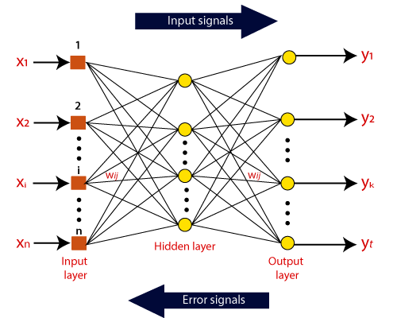

Slide 102
Afterward, each of the input is multiplied by its corresponding weights ( these weights are the details utilized by the artificial neural networks to solve a specific problem ).
In general terms, these weights normally represent the strength of the interconnection between neurons inside the artificial neural network.
All the weighted inputs are summarized inside the computing unit.
If the weighted sum is equal to zero, then bias is added to make the output non-zero or something else to scale up to the system's response.

Slide 103
Bias has the same input, and weight equals to 1. Here the total of weighted inputs can be in the range of 0 to positive infinity.
Here, to keep the response in the limits of the desired value, a certain maximum value is benchmarked, and the total of weighted inputs is passed through the activation function.
The activation function refers to the set of transfer functions used to achieve the desired output.
There is a different kind of the activation function, but primarily either linear or non-linear sets of functions.

Slide 104
Some of the commonly used sets of activation functions are the Binary, linear, and Tan hyperbolic sigmoidal activation functions.
Binary:
In binary activation function, the output is either a one or a 0. Here, to accomplish this, there is a threshold value set up.
If the net weighted input of neurons is more than 1, then the final output of the activation function is returned as one or else the output is returned as 0.

Slide 105
Sigmoidal Hyperbolic:
The Sigmoidal Hyperbola function is generally seen as an "S" shaped curve.
Here the tan hyperbolic function is used to approximate output from the actual net input. The function is defined as:
F(x) = (1/1 + exp(-????x))
Where ???? is considered the Steepness parameter.

Slide 106
Applications of Neural Networks
They can perform tasks that are easy for a human but difficult for a machine −
Aerospace − Autopilot aircrafts, aircraft fault detection.
Automotive − Automobile guidance systems.
Military − Weapon orientation and steering, target tracking, object discrimination, facial recognition, signal/image identification.
Electronics − Code sequence prediction, IC chip layout, chip failure analysis, machine vision, voice synthesis.

Slide 107
Financial − Real estate appraisal, loan advisor, mortgage screening, corporate bond rating, portfolio trading program, corporate financial analysis, currency value prediction, document readers, credit application evaluators.
Industrial − Manufacturing process control, product design and analysis, quality inspection systems, welding quality analysis, paper quality prediction, chemical product design analysis, dynamic modelling of chemical process systems, machine maintenance analysis, project bidding, planning, and management.
Medical − Cancer cell analysis, EEG and ECG analysis, prosthetic design, transplant time optimizer.

Slide 108
Speech − Speech recognition, speech classification, text to speech conversion.
Telecommunications − Image and data compression, automated information services, real-time spoken language translation.
Transportation − Truck Brake system diagnosis, vehicle scheduling, routing systems.
Software − Pattern Recognition in facial recognition, optical character recognition, etc.

Slide 109
Time Series Prediction − ANNs are used to make predictions on stocks and natural calamities.
Signal Processing − Neural networks can be trained to process an audio signal and filter it appropriately in the hearing aids.
Control − ANNs are often used to make steering decisions of physical vehicles.
Anomaly Detection − As ANNs are expert at recognizing patterns, they can also be trained to generate an output when something unusual occurs that misfits the pattern.

Slide 110
MARKET BASKET ANALYSIS
WHAT IS MARKET BASKET ANALYSIS?
The most accurate Market Analysis definition is – a data mining technique that is used to uncover purchase patterns in any retail setting.
The goal of Market Basket Analysis is to understand consumer behavior by identifying relationships between the items that people buy.
For example, people who buy green tea are also likely to buy honey.
So Market Basket Analysis would quantitatively establish that there is a relationship between Green Tea and Honey.
The same goes for bread, butter, and jam.

Slide 111
How does market basket analysis work?
Market Basket Analysis is modeled on Association rule mining, i.e., the IF {}, THEN {} construct.
For example, IF a customer buys bread, THEN he is likely to buy butter as well.
Association rules are usually represented as: {Bread} -> {Butter}
Some terminologies to familiarise with Market Basket Analysis are:

Slide 112
Antecedent:
Items or ‘item sets’ found within the data are antecedents. In simpler words, it’s the IF component, written on the left-hand side. In the above example, bread is the antecedent.
Consequent:
A consequent is an item or set of items found in combination with the antecedent. It’s the THEN component, written on the right-hand side. In the above example, butter is the consequent.

Slide 113
TYPES OF MARKET BASKET ANALYSIS
Market Basket Analysis techniques can be categorized based on how the available data is utilized:
Descriptive market basket analysis:
This type only derives insights on past data and is the most frequently used approach.
The analysis here does not make any predictions but simply rates the association between products using statistical techniques.
This type of modeling is known as unsupervised learning.

Slide 114
Predictive market basket analysis:
This type uses supervised learning models like classification and regression.
It essentially aims to mimic the market to analyze what causes what to happen.
For example, buying an extended warranty is more likely to follow the purchase of an iPhone.
Essentially, it considers items purchased in a sequence to determine cross-selling. While it isn’t as widely used as a descriptive MBA, it is still a very valuable tool for marketers.

Slide 115
Differential market basket analysis:
This type of analysis is a beneficial tool for competitor analysis.
It compares purchase history between stores, between seasons, between two time periods, between different days of the week, etc., to find interesting patterns in consumer behavior.
For example, it can help determine why some users prefer to purchase the same product with the same price on Amazon vs. Flipkart – the answer can simply be that the Amazon reseller has more warehouses and can deliver faster, or maybe something more profound like user experience.

Slide 116
ALGORITHMS ASSOCIATED WITH MARKET BASKET ANALYSIS
The market analysis definition is modeled on Association Mining rules.
Algorithms that use association mining include AIS, SETM, and Apriori.
Among these, the most commonly used algorithm for MBA is the Apriori Algorithm.
This algorithm is useful for unsupervised learning that does not require any training and thus no predictions.
The Apriori algorithm is especially useful with large datasets but it employs simple procedures to find useful relationships among the items.

Slide 117
The shortcut that this algorithm uses is the “apriori property” which states that all suggests of a frequent item set must also be frequent.
What this means in simple English is that the items in an item set need to be common in the overall dataset.
This simple rule saves a tremendous amount of computational time.

Slide 118
Association Rule Learning
The heart of market basket analysis are association rules. Association rules explain patterns of relationship among items.
Association rule learning is a type of unsupervised learning technique that checks for the dependency of one data item on another data item and maps accordingly so that it can be more profitable.
It tries to find some interesting relations or associations among the variables of dataset.
It is based on different rules to discover the interesting relations between variables in the database.

Slide 119
The association rule learning is one of the very important concepts of machine learning, and it is employed in Market Basket analysis, Web usage mining, continuous production, etc.
Here market basket analysis is a technique used by the various big retailer to discover the associations between items.
We can understand it by taking an example of a supermarket, as in a supermarket, all products that are purchased together are put together.

Slide 120
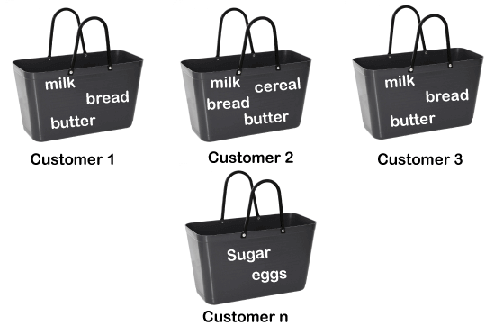
For example, if a customer buys bread, he most likely can also buy butter, eggs, or milk, so these products are stored within a shelf or mostly nearby. Consider the below diagram:

Slide 121
Association rule learning can be divided into three types of algorithms:
Apriori
Eclat
F-P Growth Algorithm

Slide 122

How does Association Rule Learning work?
Association rule learning works on the concept of If and Else Statement, such as if A then B.
Here the If element is called antecedent, and then statement is called as Consequent.
These types of relationships where we can find out some association or relation between two items is known as single cardinality.
It is all about creating rules, and if the number of items increases, then cardinality also increases accordingly.

Slide 123
So, to measure the associations between thousands of data items, there are several metrics. These metrics are given below:
- Support
- Confidence
- Lift
Support is the frequency of A or how frequently an item appears in the dataset.
It is defined as the fraction of the transaction T that contains the item set X. If there are X datasets, then for transactions T, it can be written as:

Slide 124
Confidence
Confidence indicates how often the rule has been found to be true.
Or how often the items X and Y occur together in the dataset when the occurrence of X is already given.
It is the ratio of the transaction that contains X and Y to the number of records that contain X.

Slide 125
Lift
It is the strength of any rule, which can be defined as below formula:

Slide 126
It is the ratio of the observed support measure and expected support if X and Y are independent of each other. It has three possible values:
If Lift= 1: The probability of occurrence of antecedent and consequent is independent of each other.
Lift>1: It determines the degree to which the two itemsets are dependent to each other.
Lift<1: It tells us that one item is a substitute for other items, which means one item has a negative effect on another.

Slide 127
Types of Association Rule Learning
Association rule learning can be divided into three algorithms:
Apriori Algorithm
This algorithm uses frequent datasets to generate association rules.
It is designed to work on the databases that contain transactions. This algorithm uses a breadth-first search and Hash Tree to calculate the item set efficiently.
It is mainly used for market basket analysis and helps to understand the products that can be bought together. It can also be used in the healthcare field to find drug reactions for patients.

Slide 128
Eclat Algorithm
Eclat algorithm stands for Equivalence Class Transformation. This algorithm uses a depth-first search technique to find frequent itemsets in a transaction database. It performs faster execution than Apriori Algorithm.
F-P Growth Algorithm
The F-P growth algorithm stands for Frequent Pattern, and it is the improved version of the Apriori Algorithm. It represents the database in the form of a tree structure that is known as a frequent pattern or tree. The purpose of this frequent tree is to extract the most frequent patterns.

Slide 129
Applications of Association Rule Learning
It has various applications in machine learning and data mining. Below are some popular applications of association rule learning:
Market Basket Analysis: It is one of the popular examples and applications of association rule mining. This technique is commonly used by big retailers to determine the association between items.
Medical Diagnosis: With the help of association rules, patients can be cured easily, as it helps in identifying the probability of illness for a particular disease.
Protein Sequence: The association rules help in determining the synthesis of artificial Proteins.
It is also used for the Catalog Design and Loss-leader Analysis and many more other applications.

Slide 130
Market Basket Analysis examples by market segment:
Retail:
Perhaps the most well-known MBA case-study is Amazon.com. Any time you view a product on Amazon, the product page automatically recommends, “Items bought together frequently.”
It is perhaps the simplest and most clean example of cross-selling techniques using MBA.
Apart from e-commerce formats, BA is also widely applicable to the in-store retail segment.
Grocery stores pay meticulous attention to product placement based and shelving optimization.
For example, you are almost always likely to find shampoo and conditioner placed very close to each other at the grocery store.

Slide 131
Telecom:
With the ever-increasing competition in the telecom sector, companies are paying close attention to the services that customers are frequently using.
For example, Telecom has now started to bundle TV and Internet packages apart from other discounted online services to reduce churn.
IBFS:
Tracing credit card history is a hugely advantageous MBA opportunity for IBFS organizations.
For example, Citibank frequently employs sales personnel at large malls to lure potential customers with attractive discounts on the go.

Slide 132
They also associate with apps like Swiggy and Zomato to show customers a multitude of offers they can avail via purchasing through credit cards.
IBFS organizations also use basket analysis to determine fraudulent claims.
Medicine:
In the medical field, basket analysis is used to determine comorbid conditions and symptom analysis.
It can also help identify which genes or traits are hereditary and which are associated with local environmental effects.
DRDO has run a detailed study that associated clinical parameters with the diagnosis of brain tumors.

Slide 133
BENEFITS OF MARKET BASKET ANALYSIS
Increasing market share:
Once a company hits peak growth, it becomes challenging to determine new ways of increasing market share.
Market Basket Analysis can be used to put together demographic and gentrification data to determine the location of new stores or geo-targeted ads. For example, if you’ve ever wondered how there’s a Mcdonald’s everywhere you go, the answer can likely come from MBA.
2. Behavior analysis: Understanding customer behavior patterns is a primal stone in the foundations of marketing. MBA can be used anywhere from a simple catalog design to UI/UX.

Slide 134
3. Optimization of in-store operations: MBA is not only helpful in determining what goes on the shelves but also behind the store. Geographical patterns play a key role in determining the popularity or strength of certain products, and therefore, MBA has been increasingly used to optimize inventory for each store or warehouse.
4. Campaigns and promotions: Not only is MBA used to determine which products go together but also about which products form keystones in their product line. For example, companies may notice that frequently restocking gourmet bread increases the purchase of other related gourmet jams and jellies.

Slide 135
5. Recommendations:
OTT platforms like Netflix and Amazon Prime benefit from MBA by understanding what kind of movies people tend to watch frequently.
For example, a person who rated Money Heist highly could also be interested in other high-crime series.

Slide 136
Planning in AI
What is planning in AI?
The planning in Artificial Intelligence is about the decision making tasks performed by the robots or computer programs to achieve a specific goal.
The execution of planning is about choosing a sequence of actions with a high likelihood to complete the specific task.

Slide 137
Blocks-World planning problem
The blocks-world problem is known as Sussman Anomaly.
Noninterleaved planners of the early 1970s were unable to solve this problem, hence it is considered as anomalous.
When two subgoals G1 and G2 are given, a noninterleaved planner produces either a plan for G1 concatenated with a plan for G2, or vice-versa.
In blocks-world problem, three blocks labeled as 'A', 'B', 'C' are allowed to rest on the flat surface. The given condition is that only one block can be moved at a time to achieve the goal.

Slide 138
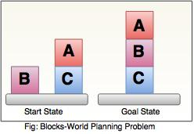
The start state and goal state are shown in the following diagram.

Slide 139
Components of Planning System
The planning consists of following important steps :
Choose the best rule for applying the next rule based on the best available heuristics.
Apply the chosen rule for computing the new problem state.
Detect when a solution has been found.
Detect dead ends so that they can be abandoned and the system’s effort is directed in more fruitful directions.
Detect when an almost correct solution has been found.

Slide 140
Goal stack planning
This is one of the most important planning algorithms, which is specifically used by STRIPS.
The stack is used in an algorithm to hold the action and satisfy the goal.
A knowledge base is used to hold the current state, actions.
Goal stack is similar to a node in a search tree, where the branches are created if there is a choice of an action.

Slide 141
The important steps of the algorithm are as stated below: i. Start by pushing the original goal on the stack. Repeat this until the stack becomes empty. If stack top is a compound goal, then push its unsatisfied sub goals on the stack. ii. If stack top is a single unsatisfied goal then, replace it by an action and push the action’s precondition on the stack to satisfy the condition. iii. If stack top is an action, pop it from the stack, execute it and change the knowledge base by the effects of the action. iv. If stack top is a satisfied goal, pop it from the stack.

Slide 142
Non-linear planning
This planning is used to set a goal stack and is included in the search space of all possible subgoal orderings. It handles the goal interactions by interleaving method. Advantage of non-Linear planning Non-linear planning may be an optimal solution with respect to plan length (depending on search strategy used). Disadvantages of Nonlinear planning It takes larger search space, since all possible goal orderings are taken into consideration.
Complex algorithm to understand.

Slide 143
Algorithm 1. Choose a goal 'g' from the goalset 2. If 'g' does not match the state, thenChoose an operator 'o' whose add-list matches goal g
Push 'o' on the opstack
Add the preconditions of 'o' to the goalset
3. While all preconditions of operator on top of opstack are met in statePop operator o from top of opstack
state = apply(o, state)
plan = [plan; o]

Slide 144
Partial order planning
In partial ordered planning (POP), ordering of the actions is partial. Also partial ordered planning don’t specify which action will come first out of the two actions which are placed.
With partial ordered planning, problem can be decomposed, so it can work well in case the environment is non-cooperative.
E.g. Partial order planning of Wearing Shoe

Slide 145
It combines two action sequence:
i. First branch covers left sock and left shoe.
ii. In case, to wear a left shoe, wearing left sock is precondition, similarly.
iii. Second branch covers right sock and right shoe.
iv. Here, wearing a right sock is precondition for wearing the right shoe.
Once these actions are taken we achieve our goal and reach the finish state.

Slide 146
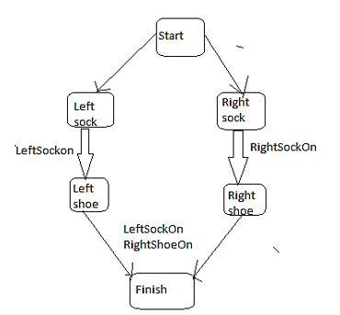

Slide 147
Pop as search problem:
Set of actions:
These are the steps of plan.
For e.g.: Set of Actions = {Start, Rightsock, Rightshoe ,Leftsock, Leftshoe, Finish}
Set of ordering constraints/preconditions:
i. Preconditions are considered as ordering constraints.(i.e. without performing action “x” we cannot perform action “y”)
ii. For e.g.: Set of ordering = {Right-sock <right-shoe; left-sock<left-shoe}

Slide 148
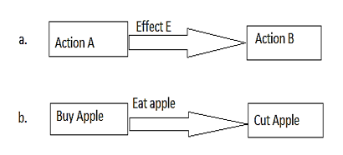
Set of causal links:
Action A achieves effect “E” for action B
i. You can understand that if you buy an apple its effect can be eating an apple and the precondition of eating an apple is cutting apple.

Slide 149
ii. For e.g. Set of Causal Links = {Right-sock-> Right-sock-on
Set of open preconditions:
i. Preconditions are called open if it cannot be achieved by some actions in the plan.
ii. Consistent Plan is a Solution for POP Problem
iii. A consistent Plan doesn’t have cycle of constraints; it doesn’t have conflicts in the causal links and doesn’t have open preconditions so it can provide a solution for POP problem.

